Slide 1
JSON WEB TOKEN(JWT)
BY:
SHIVI AGRAWAL
(1403210197)
CSE-(6)C

Slide 2
CONTENTS
Introduction
Cookie Based Authentication
Token Based Authentication
JSON Web Token
When to use JWT?
JWT Structure
How JWT works?
JWT v/s other methods
Cons
Refrences

Slide 3
INTRODUCTION
Authentication
Ways to authenticate
(i). Cookie based (Stateful Authentication)
(ii). Token based (Stateless Authentication)

Slide 4
Cookie Based Authentication
Stateful : An authentication record or session must be maintained. The server needs to keep track of active sessions in a database.
Every request is accompanied by a cookie.
Whenever the user makes a request, the server validates the cookie and session Id.
Basic flow using cookie authentication:

Slide 5
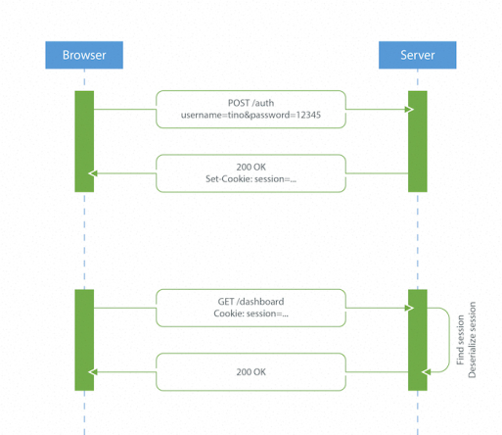

Slide 6
Procedure
User enters their login credentials.
Server verifies the credentials are correct and creates a session which is then stored in a database.
A cookie with the session ID is placed in the users browser.
On further requests, the session ID is verified against the database and if valid, the request processed.
Once a user logs out of the app, the session is destroyed both client and server side.

Slide 7
Features
Stateful
Coupling with web framework
Cross Origin Request Sharing(CORS)
No data storage
Performance

Slide 8
Token Based Authentication
Stateless: The server does not keep a record of which users are logged in . Instead, every request to the server is accompanied by a token which the server uses to verify the authenticity of the request.
Basic Flow of token based authentication:

Slide 9
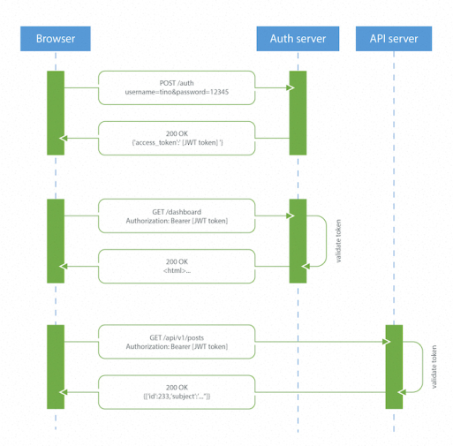

Slide 10
Procedure
User enters their login credentials.
Server verifies the credentials are correct and returns a signed token.
This token is stored client-side, most commonly in local storage.
Subsequent requests to the server include this token as an additional Authorization header.
The server decodes the JWT and if the token is valid processes the request
Once a user logs out, the token is destroyed client-side.

Slide 11
Features
Stateless
CORS / Cross-Domain
Data Storage
Performance
Compact and Self Contained
Easy implementation on Mobile
Hence, Token based authentication is better than Cookie based authentication.

Slide 12
JSON Web Tokens
JSON Web Token (JWT) is a compact, open standard means of representing claims to be transferred between two parties. These are encoded as a JSON object that is used as the payload of a JSON Web Signature (JWS) structure or as the plaintext of a JSON Web Encryption (JWE) structure, enabling the claims to be digitally signed.
In layman’s language, JSON Web Token(JWT) is a self-verified encoded string that is used in Modern Web/Mobile app for both Authentication and Authorization. The fact that it is stateless removes the maintenance efforts that we need for other Authentication and Authorization tools. It is used as a replacement to cookies, or rather improvement over cookies.
Compact and Self Contained.
Used by Node.js, Ruby, python etc.

Slide 13
When to use JWT?
Authentication : Once the user is logged in, each subsequent request will include the JWT, allowing the user to access routes, services, and resources that are permitted with that token. It’s a feature that widely because of its small overhead and its ability to be easily used across different domains.
Information Exchange: JSON Web Tokens are a good way of securely transmitting information between parties, because as they can be signed, for example using public/private key pairs, you can be sure that the senders are who they say they are. You can also verify that the content hasn't been tampered. (using header and payload)

Slide 14
JWT Structure
JWT Tokens consists of three parts appended by a (dot).
Header: type of token, hash algorithm
Payload: claims (public, private and reserved)
Signature

Slide 15
HEADER

Slide 16
PAYLOAD
Common claims are:
Issuer (iss)
Subject (sub)
Audience (aud)
Expiration time (exp)
Not before (nbf)
Issued at (iat)
JWT ID (jti)

Slide 17
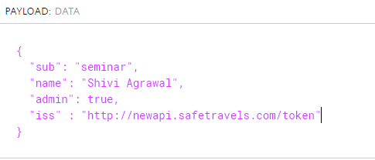

Slide 18
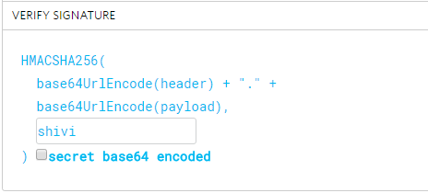
SIGNATURE

Slide 19
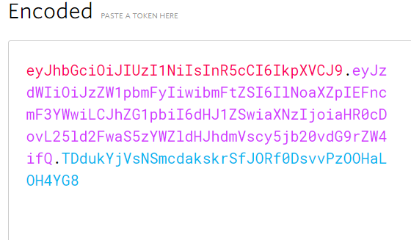
OUTPUT (JWT)

Slide 20
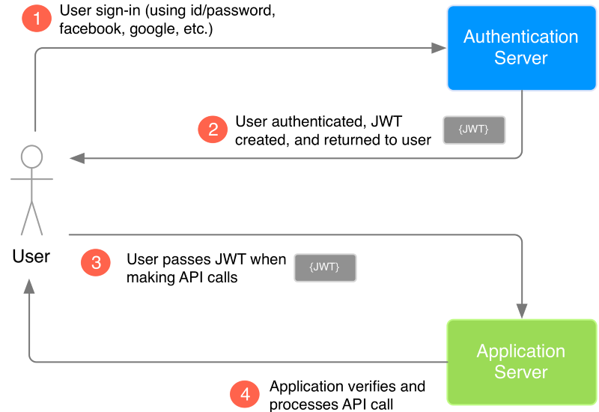
How JWT works?
Notes:
At step 3, Whenever the user wants to access a protected route, it should send the JWT, typically in the Authorization header using the Bearer schema. Therefore, the content of the header should look like the following: Authorisation: Bearer<Token>

Slide 21
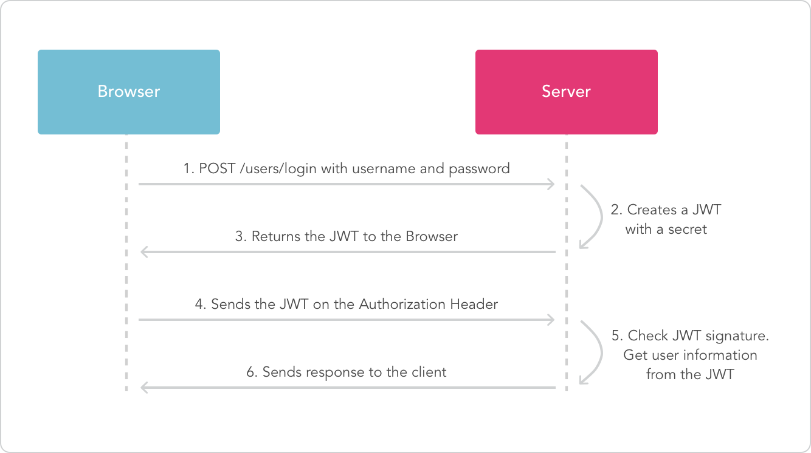

Slide 22
JWT v/s Other Token Methods
Better than Simple Web Token(SWT) and SAML(Simple Assertion Markup Language).
Less verbose.
Security
Common parser
Notes:
jwt.io samltool.io

Slide 23
Cons of JWT
Data Overhead.
Security of whole platform will be compromised if the secret key is leaked.

Slide 24
REFRENCES
https://jwt.io
https://auth0.com/blog/cookies-vs-tokens-definitive-guide/
https://auth0.com/blog/json-web-token-signing-algorithms-overview/
https://medium.com/vandium-software/5-easy-steps-to-understanding-json-web-tokens-jwt-1164c0adfcec

Slide 25
Your Queries Please !

Slide 26
Thank you!

