Slide 1
Advanced central locking

Slide 2
What is the need?
Motor vehicle theft is the criminal act of stealing or attempting to steal a car (or any other motor vehicle). Nationwide in the US in 2012, there were an estimated 721,053 motor vehicle thefts, or approximately 229.7 motor vehicles stolen for every 100,000 inhabitants. Property losses due to motor vehicle theft in 2012 were estimated at $4.3 billion
Information tabled in the Lok Sabha shows that as many as 1.65 lakh vehicles were stolen in a single year—2013

Slide 3
How thieves attack the car
Theft of an unattended vehicle without key(s)
Theft with access to keys
Opportunistic theft
Carjacking
Fraudulent theft

Slide 4
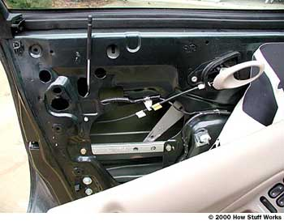

Slide 5
How the product work
The central lock Is attached to the micro controller, through which the central lock will work.
The micro controller would be connected by our android application
There is Unique product id and password for secure access.
This id and password will be verified by our server and a new account of the car and owner would be created .
If some one tries to access the same car initially registered; then a mail would be generated for permission to new user as well as the owner up to 5 user.

Slide 7
Marketing strategy
Advance Central locking | Central locking
Protection from unwilling door opening | Can’t protect from door opening (wire hanger)
Protection from unwilling unlocking | Vulnerable to unlocking
Protection from key lost | Vulnerable to key lost
Price is almost equal to central locking

Slide 8
Viability of the product
The product is equally viable as compared to central locking system.
Software cost is complemented by the reduced hardware cost.
There is a 14% hike in cost as compared to central locking
(3990+14%)= Rs. 4550

Slide 9
THANK YOU

